Slide 1
Monocular depth estimation
201820894 유원균

Slide 2

목차
A table of contents.
1
Model Architecture
2
Q&A

Slide 3

Part 1.
Model
Architecture

Slide 4
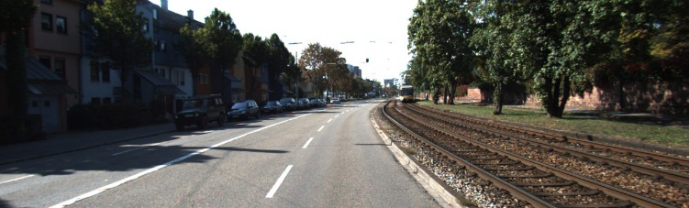
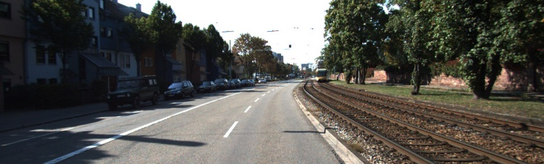
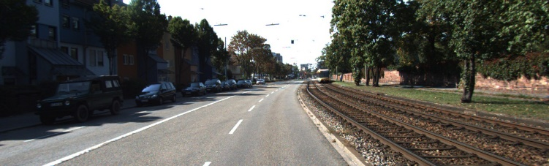

t-1 frame
t frame
t+1 frame
1. Depth Network
: Encoder-Decoder
Resnet-18
Depth Decoder
2. Disparity output
: Sigmoid
3. Depth prediction
: D=1/(a$σ$+b)
Depth network

Slide 5
t-1 frame
t frame
t+1 frame
1. Pose Network
: Encoder-Decoder
1. Depth Network
: Encoder-Decoder
Resnet-18
Resnet-18
Pose
Decoder
Depth Decoder
2. Axisangle, Translation output
2. Disparity output
: Sigmoid
3. Rotation, Translation matrix
3. Depth prediction
: D=1/(a$σ$+b)
Depth network

Slide 6
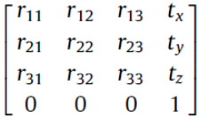
t-1 frame
t frame
t+1 frame
1. Pose Network
: Encoder-Decoder
1. Pose Network
: Encoder-Decoder
Resnet-18
Resnet-18
4. Predict pose network
: By grid search
Pose
Decoder
Pose
Decoder
2. Axisangle, Rotation output
2. Axisangle, Translation output
3. Rotation, Translation matrix(R|t)

